Slide 1
Sinhgad College of Engineering Department of Information Technology
Project Review
On
“PREDICTION OF CRYPTOCURRENCY PRICES USING MACHINE LEARNING BASED ON BLOCKCHAIN INFORMATION”
by
Roll No | Name
407001 | Himanshu Agrawal
407002 | Sacchi Agrawal
407007 | Ankur Sakhala
407023 | Amita Bodhe
Guide
“Prof. S.M.Jaybhaye”

Slide 2

Sinhgad Technical Education Society’s
SINHGAD COLLEGE OF ENGINEERING, Pune-41
Department of Information Technology
A Seminar
On
“PREDICTION OF CRYPTOCURRENCY PRICES USING MACHINE LEARNING BASED ON BLOCKCHAIN INFORMATION”
Presented By
Himanshu Deepak Agrawal
T150238501/307002 TE IT-div 1
Guided By
Prof. S.M.Jaybhaye

Slide 3

OUTLINE
1.Brief Introduction to Project
2.Seminar Topic Domain/Area
3.Introduction
4.Literature Survey
5.Seminar Title- Details, Architecture, Algorithm, Technology, Applications, Pros/Cons
6.Conclusion
7.References

Slide 4

Bitcoin
Bitcoin is a digital cryptocurrency and payment system that is entirely decentralized, meaning it is based on peertopeer transactions with no bureaucratic oversight. Transactions and liquidity within the network are instead based on cryptography
If you were to pick the three most ridiculous fads of 2017, they would deﬁnitely be ﬁdget spinners , artiﬁcial intelligence and, yes, cryptocurrencies. I am actually not a hodler of any cryptos. So, while I may not have a ticket to the moon, I can at least get on board the hype train by successfully predicting the price of cryptos by harnessing deep learning, machine learning and artiﬁcial intelligence (yes, all of them!)
Decentralization can be speciﬁed by the following goals: (i) Who will maintain and manage the transaction ledger (ii) Who will have the right to validate transactions

Slide 5
Introduction to Domain
1. In recent years, Bitcoin ecosystem has gained the attention of consumers, businesses, investors and speculators alike. As a result of blockchain – network based feature engineering , macro-economic factors of actual market and machine learning algorithms optimization, implementation of a Bayesian optimised recurrent neural network (RNN) and Long Short Term Memory (LSTM) network.
2. It operates on a decentralised, peer-to-peer and trustless system in which all transactions are posted to an open ledger called the Blockchain. This type of transparency is unheard of in other ﬁnancial markets.
3. The recurrent neural network (RNN) and the long short term memory (LSTM) ﬂavour of artiﬁcial neural networks are favoured over the traditional multilayer perceptron (MLP) due to the temporal nature of the more advanced algorithms.
4. the relationship between Bitcoin and search information, such as Google Trends and Wikipedia, and wavelet analysis of Bitcoin and BGT-Blockchain Google trends. We here will be bridging the gap between these two by Machine Learning.

Slide 6
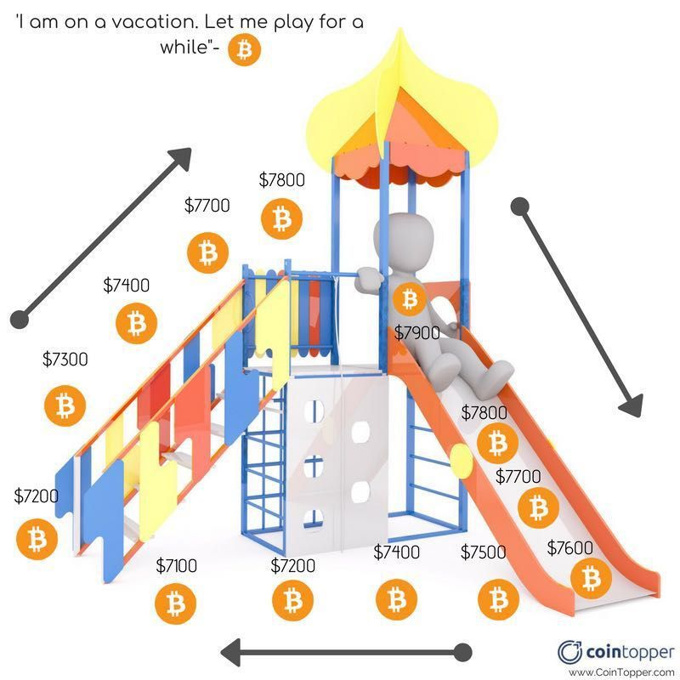
Problem statement
We are addressing the problem of huge volatility in bitcoin prices?
We also address the problem of slow and inefficient practices of humans in terms of cryptocurrency trading?

Slide 7

Brief Introduction to the Project
The ubiquity of Internet access has triggered the emergence of currencies.
Bitcoin has recently attracted considerable attention –
journey of1/4 of cent to 1000 USD.
From 21 M,16.7 M BTC found,12.5 BTC for new block i.e. 1800 new BTC daily.
Decentralized, no double spending, security by cryptography/hash/Digital signatures, public ledger gain trust.
Price is nearly unpredictable.
Business ups/ downs, Google trends affect BTC
Bridging the gap between Stats & BTC by ML.

Slide 8

Motivation
The ubiquity of Internet access has triggered the emergence of currencies.
Business ups/downs, Google trends affect BTC. To bridge the gap between Stats & BTC by ML.
Bitcoin as a currency is in a transient stage and as a result is considerably more volatile than other currencies such as the USD. Interestingly, it is the top performing currency four out of the last ﬁve years. Thus, its prediction oﬀers great potential and this provides motivation for research in the area.
ML is a vast domain, it endless applications with no saturation point.

Slide 9

Aim and Objectives of the project
The aim of this project is ﬁnd out with what accuracy the direction of the price of Bitcoin can be predicted using machine learning methods and help the user make those transactions with ease.
1. Proper data collection and ﬁnding out the perfect number and types of variables that can be the best suit.
2. To chose the most appropriate algorithm and ways to validate it, optimize it, evaluate it on various parameters for accuracy and errors.
3. Technology used also played an important role in deciding the success of a project. To select and have hands on these required stuﬀ.
4. Understanding the algorithm used at its full depth so that we can optimize it, generalize it in future.
The purpose of this study is to achieve a considerable amount of accuracy and use all the proposed research to ﬁnd out the best algorithm for cryptocurrency price prediction

Slide 10
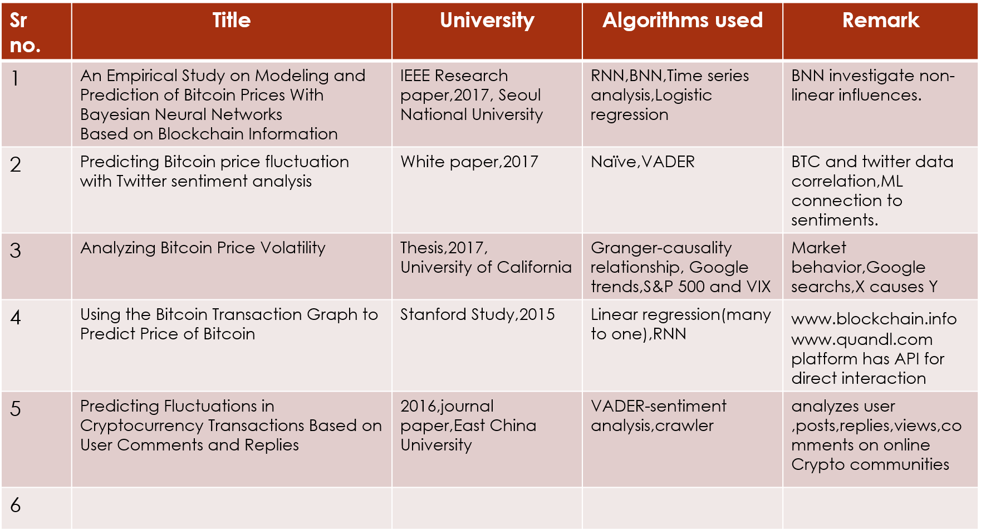
Literature Survey

Slide 11

Scope of the project
We have found all the factors affecting the price of bitcoin and all other cryptocurrencies with the help of machine learning algorithms.
This bot helps the user take decisions about trading cryptocurrencies by predicting the future prices based on various factors.
It also helps the user by making transactions automatically on their behalf.

Slide 12
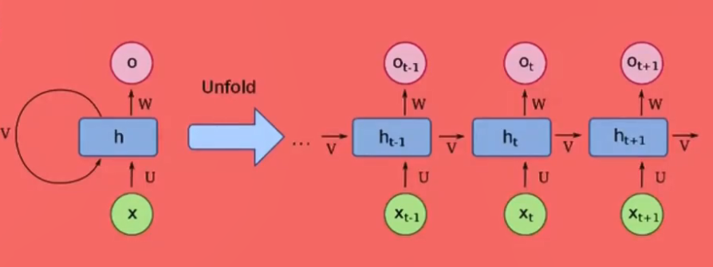
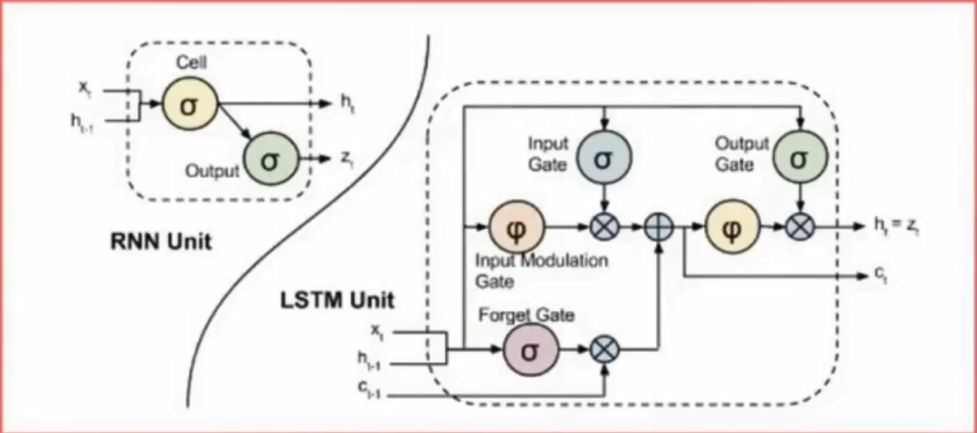
RNN VS LSTM
RNN Recurrent Neural Network has neurons that remember the previous segment but Backpropagation gave “Vanishing gradient problem”.
LSTM Long Short term Memory have blocks with gates
Forget,Input and Output gate.

Slide 13

Feature Extraction
We compiled several network-based features to develop our supervised machine learning algorithms. The feature families we selected using the following approach. The goal is to predict the price of Bitcoin in USD one min in advance. All features are computed using only information available an min prior to the target prediction time, and for node features we used both in and out degree. The following features were extracted:
current Bitcoin price
net ﬂow per hour
number of transactions per hour
mean transaction value
median transaction value
average node in- and out-degree 7. median node degree 8. alpha constant of power law 9. total number of Bitcoin mined 10. number of new addresses 11. mean initial deposit amount among new addresses 12. number of transactions performed by new addresses

Slide 14

Hardware and Software Requirements
SOFTWARE :
Scikits Library and Jupyter Notebook
Python 3.6 and above
MATLAB/Octave.
Nodejs
Hardware :
Nvidia Tesla K80
8 Gb Ram

Slide 15
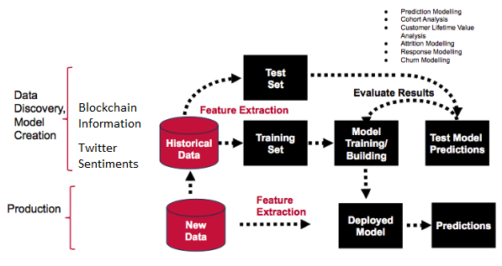
Architecture

Slide 16
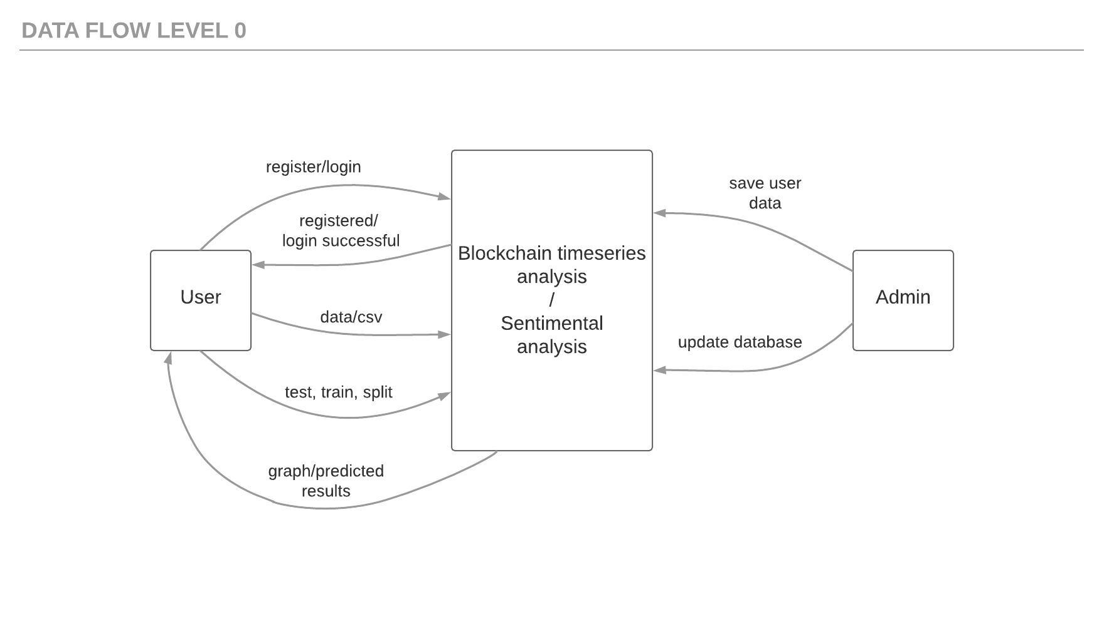

Slide 17
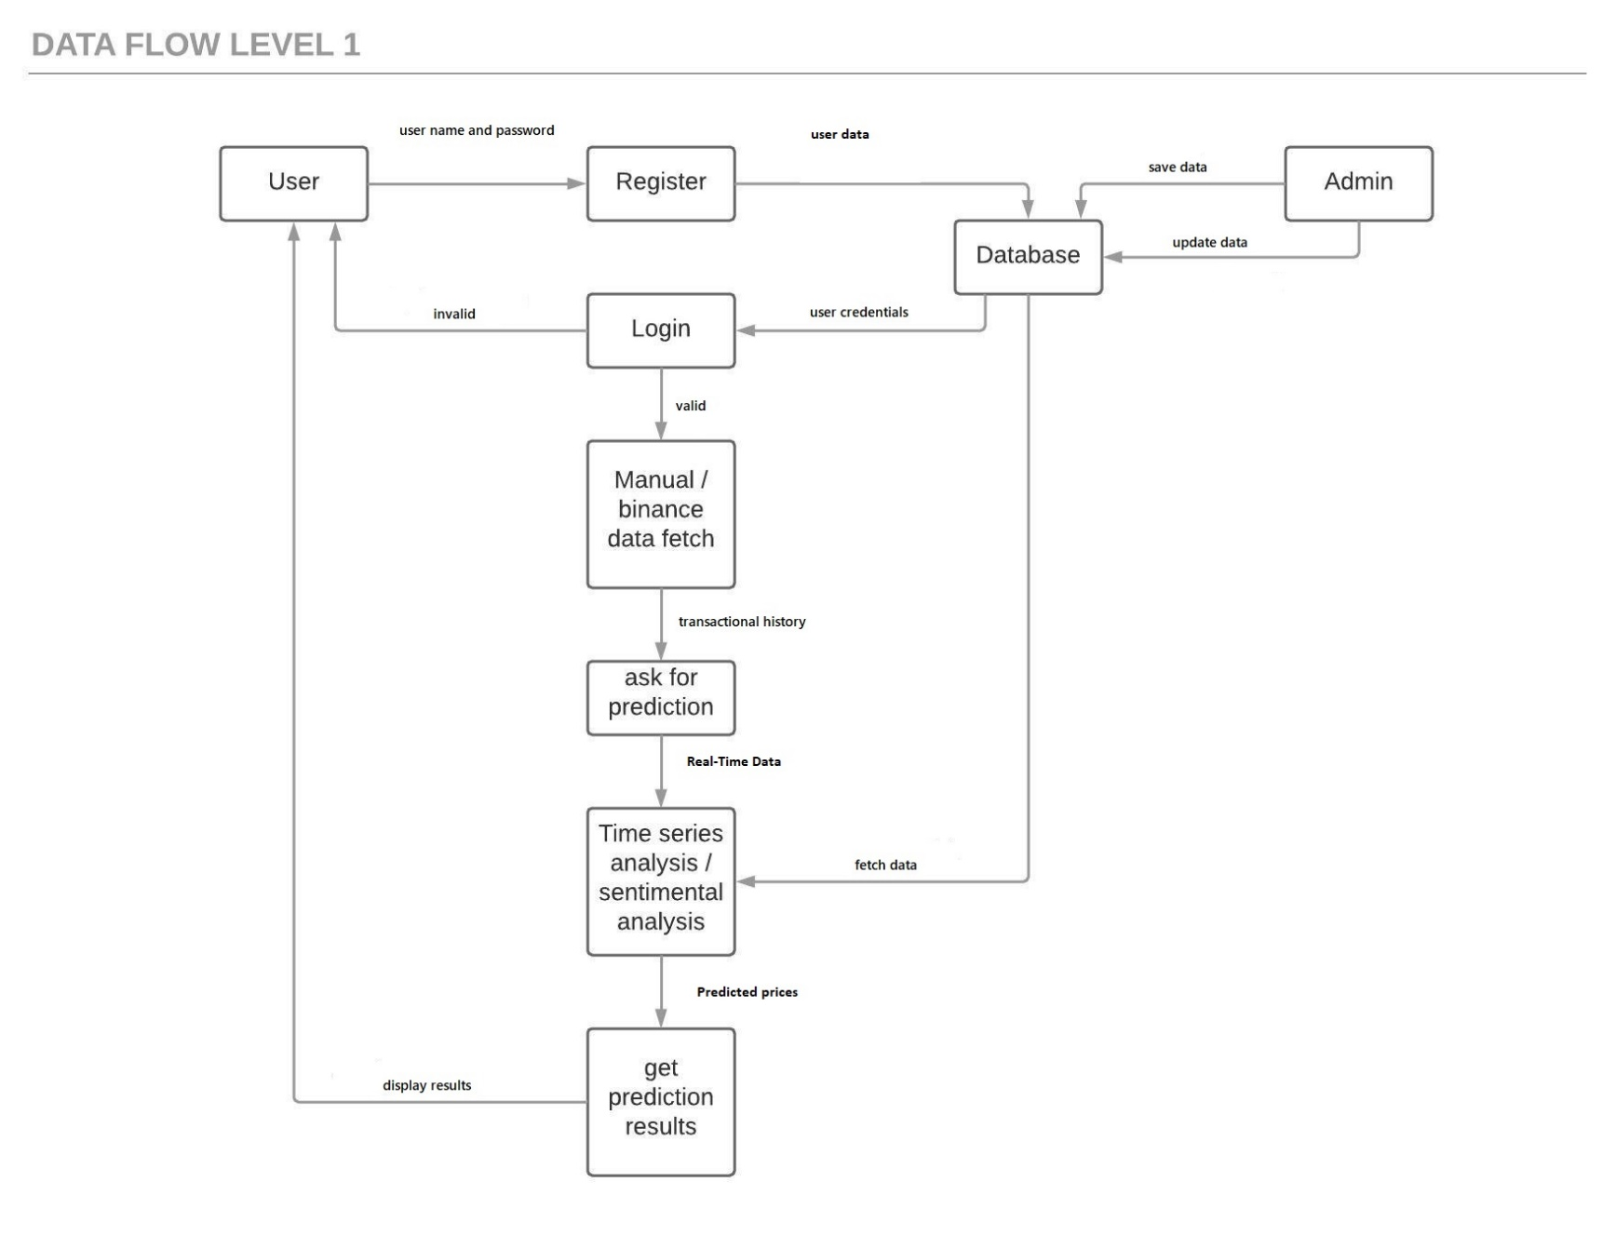

Slide 18
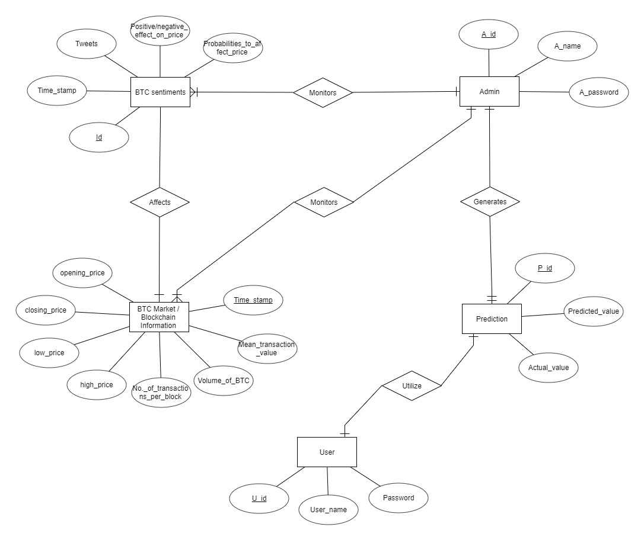
ER Diagram

Slide 19
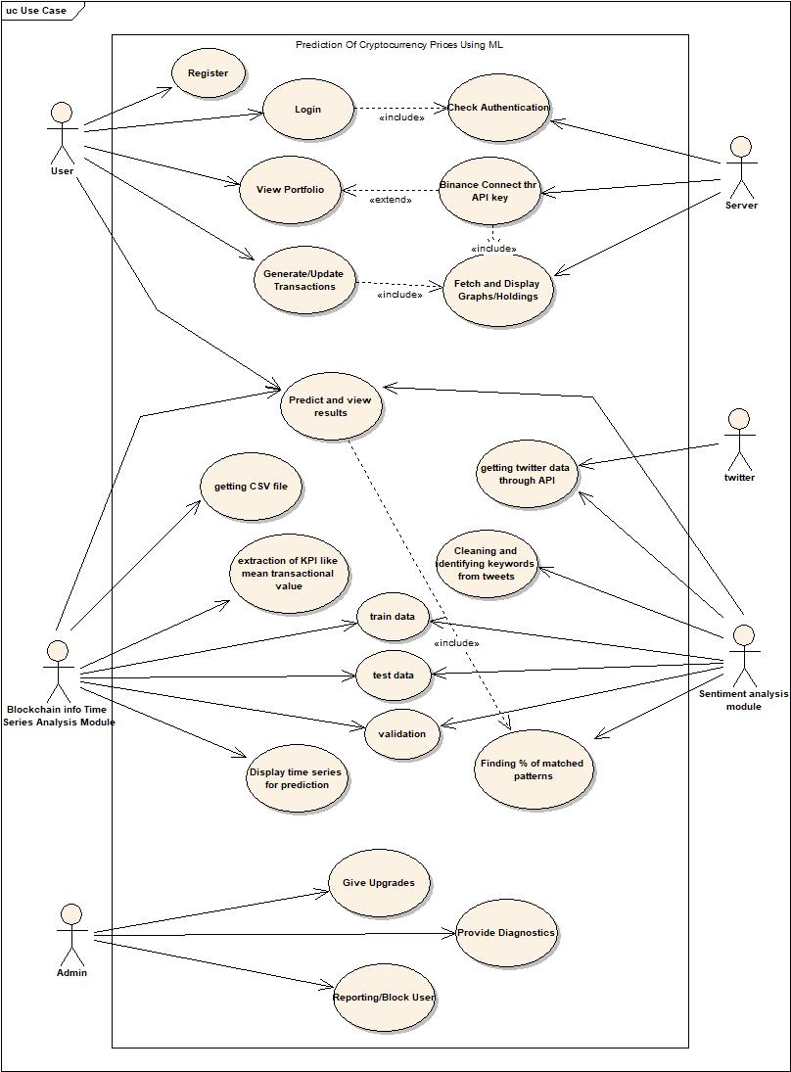
Use Case Diagram

Slide 20
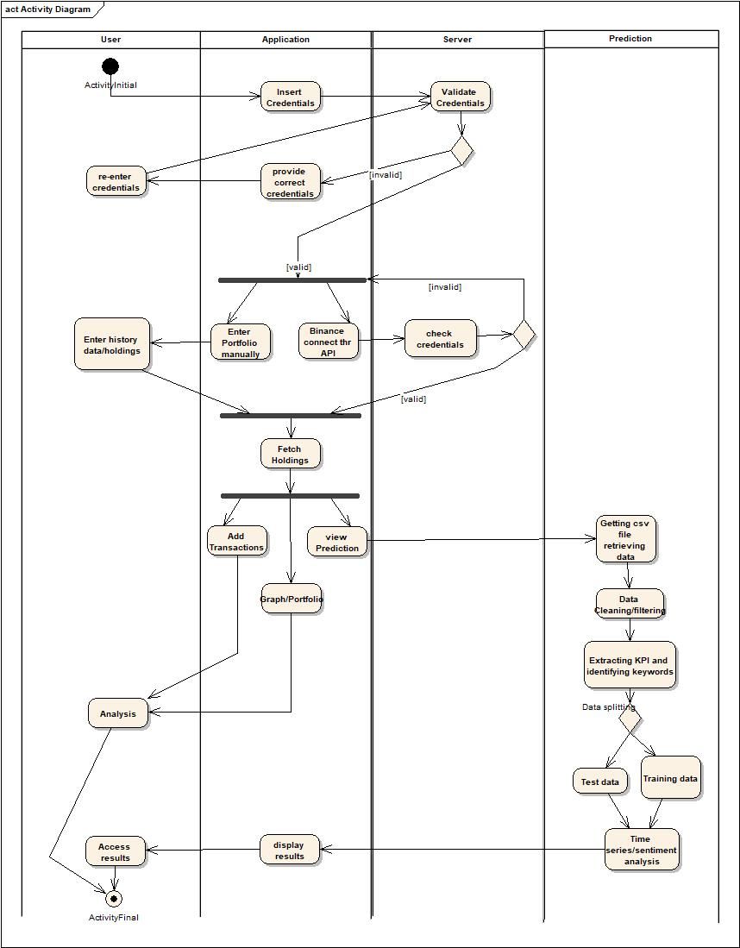
Activity Diagram

Slide 21
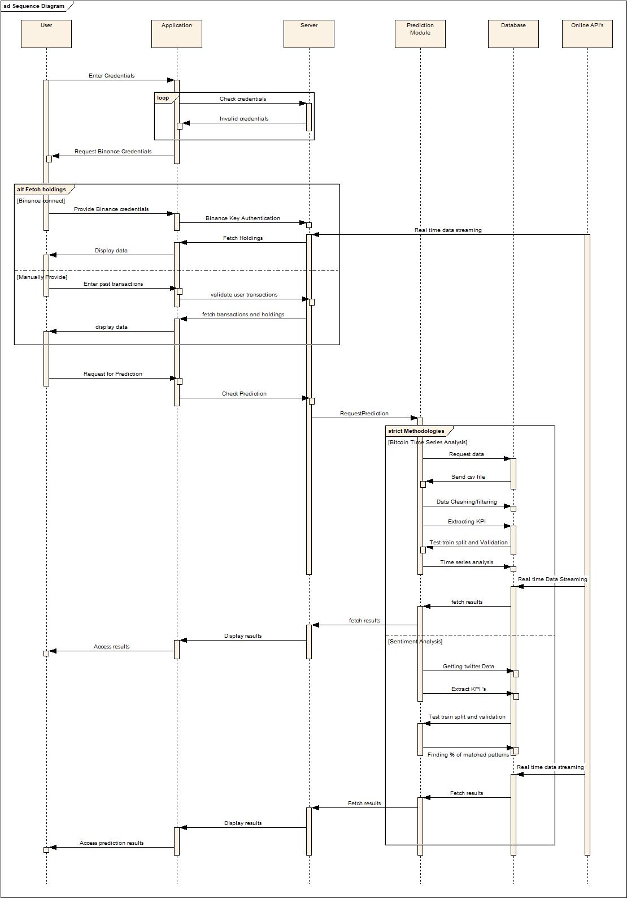
Sequence Diagram

Slide 22
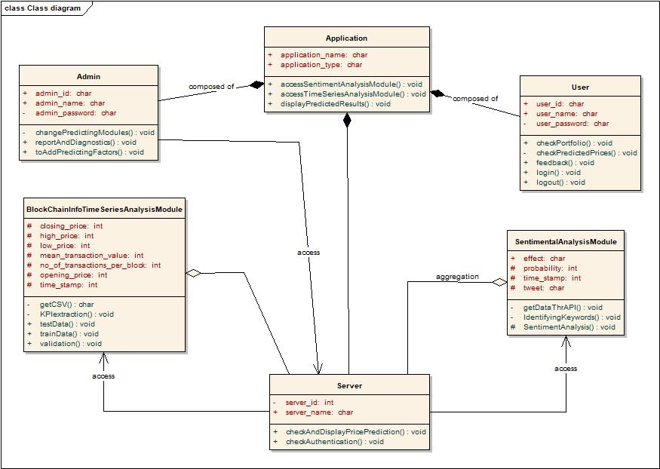

Slide 23
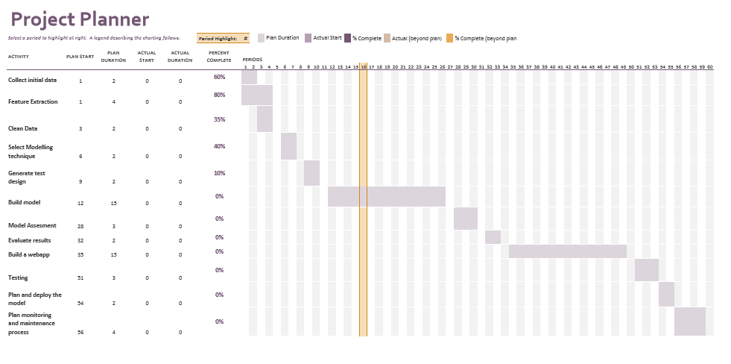

Slide 24

Web App - BLOCKPREDICT

Slide 25
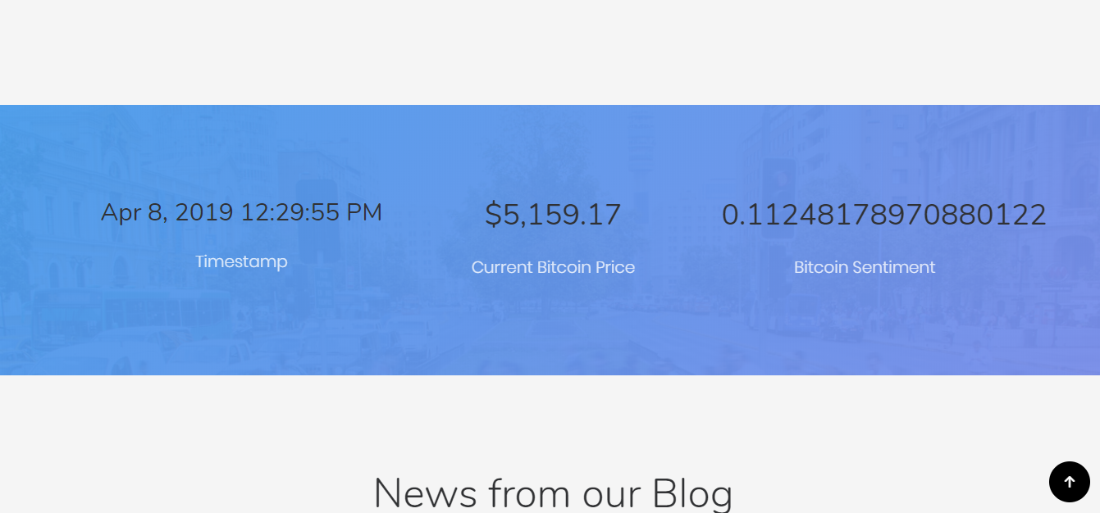
Current Bitcoin Statistics

Slide 26

Price Prediction

Slide 27

Applications
Manage the user’s cryptocurrency portfolio.
1
Able to perform transactions through simple commands on telegram.
2
Be aware of the upcoming prices of bitcoin.
3
Get help with the trading of cryptocurrencies using the trading bot.
4

Slide 28
Future Scope
To add a trade bot which connects the user’s block predict account to the user’s exchange. Then by using Predictions from the model automatically trade on behalf of the user, by generating considerable amount of proﬁt.
To train the model using more and more factors, thus increasing the accuracy of the prediction. The current loopback is set at 60, however this loopback can also be increased as long as two weeks which is equal to 20160.
Currently our model predicts prices per minute, which can be changed by providing ﬁltered dataset to predict values as far as a month ahead in the future.

Slide 29
Conclusion
This project is undertaken to design Application for BTC price prediction and evaluate results for higher accuracy.
With this project we hope to make people understand the volatility in the price of bitcoin due to all the various factors and help them make profit at the same time.
Also, we would aim to build a model which could be used to train the data for all the other cryptocurrencies in the market as well.

Slide 30

Looking back we can conclude that Deep learning models such as the RNN and LSTM are evidently eﬀective learners on training data with the LSTM more capable for recognizing longer-term dependencies.
2. However, a high variance task of this nature make it diﬃcult to transpire this into impressive validation results. As a result it remains a diﬃcult task. There is a ﬁne line to balance between overﬁtting a model and preventing it from learning suﬃciently.
3. The goal can be achieved by adopting other extended machine learning methods or considering new input capabilities related to the variability of Bitcoin.
Such study will contribute to rich Bitcoin time series analysis in addition to existing Bitcoin studies. This project is undertaken to explain what all factors aﬀect the price of BTC and how we can use them in proper Machine Learning algorithms and to evaluate the accuracy of Prediction. This study has found that ML bridges the gap between Statistics and BTC price.

Slide 31
References
Udemy - blockchain-and-bitcoin-fundamentals
Joewood Lee - “An Empirical Study on Modelling and Prediction of Bitcoin Prices With Bayesian Neural Networks Based on Blockchain Information”, December 4, 2017-IEEEexplore.com
11. Blockchain Info. https://blockchain.info/
12. Coinbase API. https://www.coinbase.com/docs/api/overview
S. Nakamoto, ``Bitcoin: A peer-to-peer electronic cash system, ''Tech. Rep., 2008.
H. Jang , J. Lee - \An Empirical Study on Modeling and Prediction of Bitcoin
Prices With Bayesian Neural Networks Based on Blockchain Information,"
December 4, 2017.
2. J. C. Soldevilla Estrada,\Analyzing Bitcoin Price Volatility," University of
California, Berkeley ,May 5, 2017.
5. S. Nakamoto, \Bitcoin: A peer-to-peer electronic cash system," 2008.
6. S. McNally, \Predicting the price of Bitcoin using machine learning," Ph.D.
dissertation, School Comput., Nat. College Ireland, Dublin, Ireland, 2016.
7. I. Madan, S. Saluja, and A. Zhao, \Automated Bitcoin trading via machine
learning algorithms," Dept. Comput. Sci., Stanford Univ., Stanford, CA,
USA, Tech. Rep., 2015.
8. Y. B. Kim1, Jun Gi Kim2, W. Kim3, Jae Ho Im3, T. H. Kim1, Shin Jin Kang2,
Chang Hun Kim3,\Predicting Fluctuations in Cryptocurrency Transactions
Based on User Comments and Replies," August 17, 2016.

